Slide 1


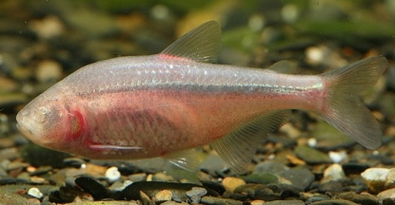
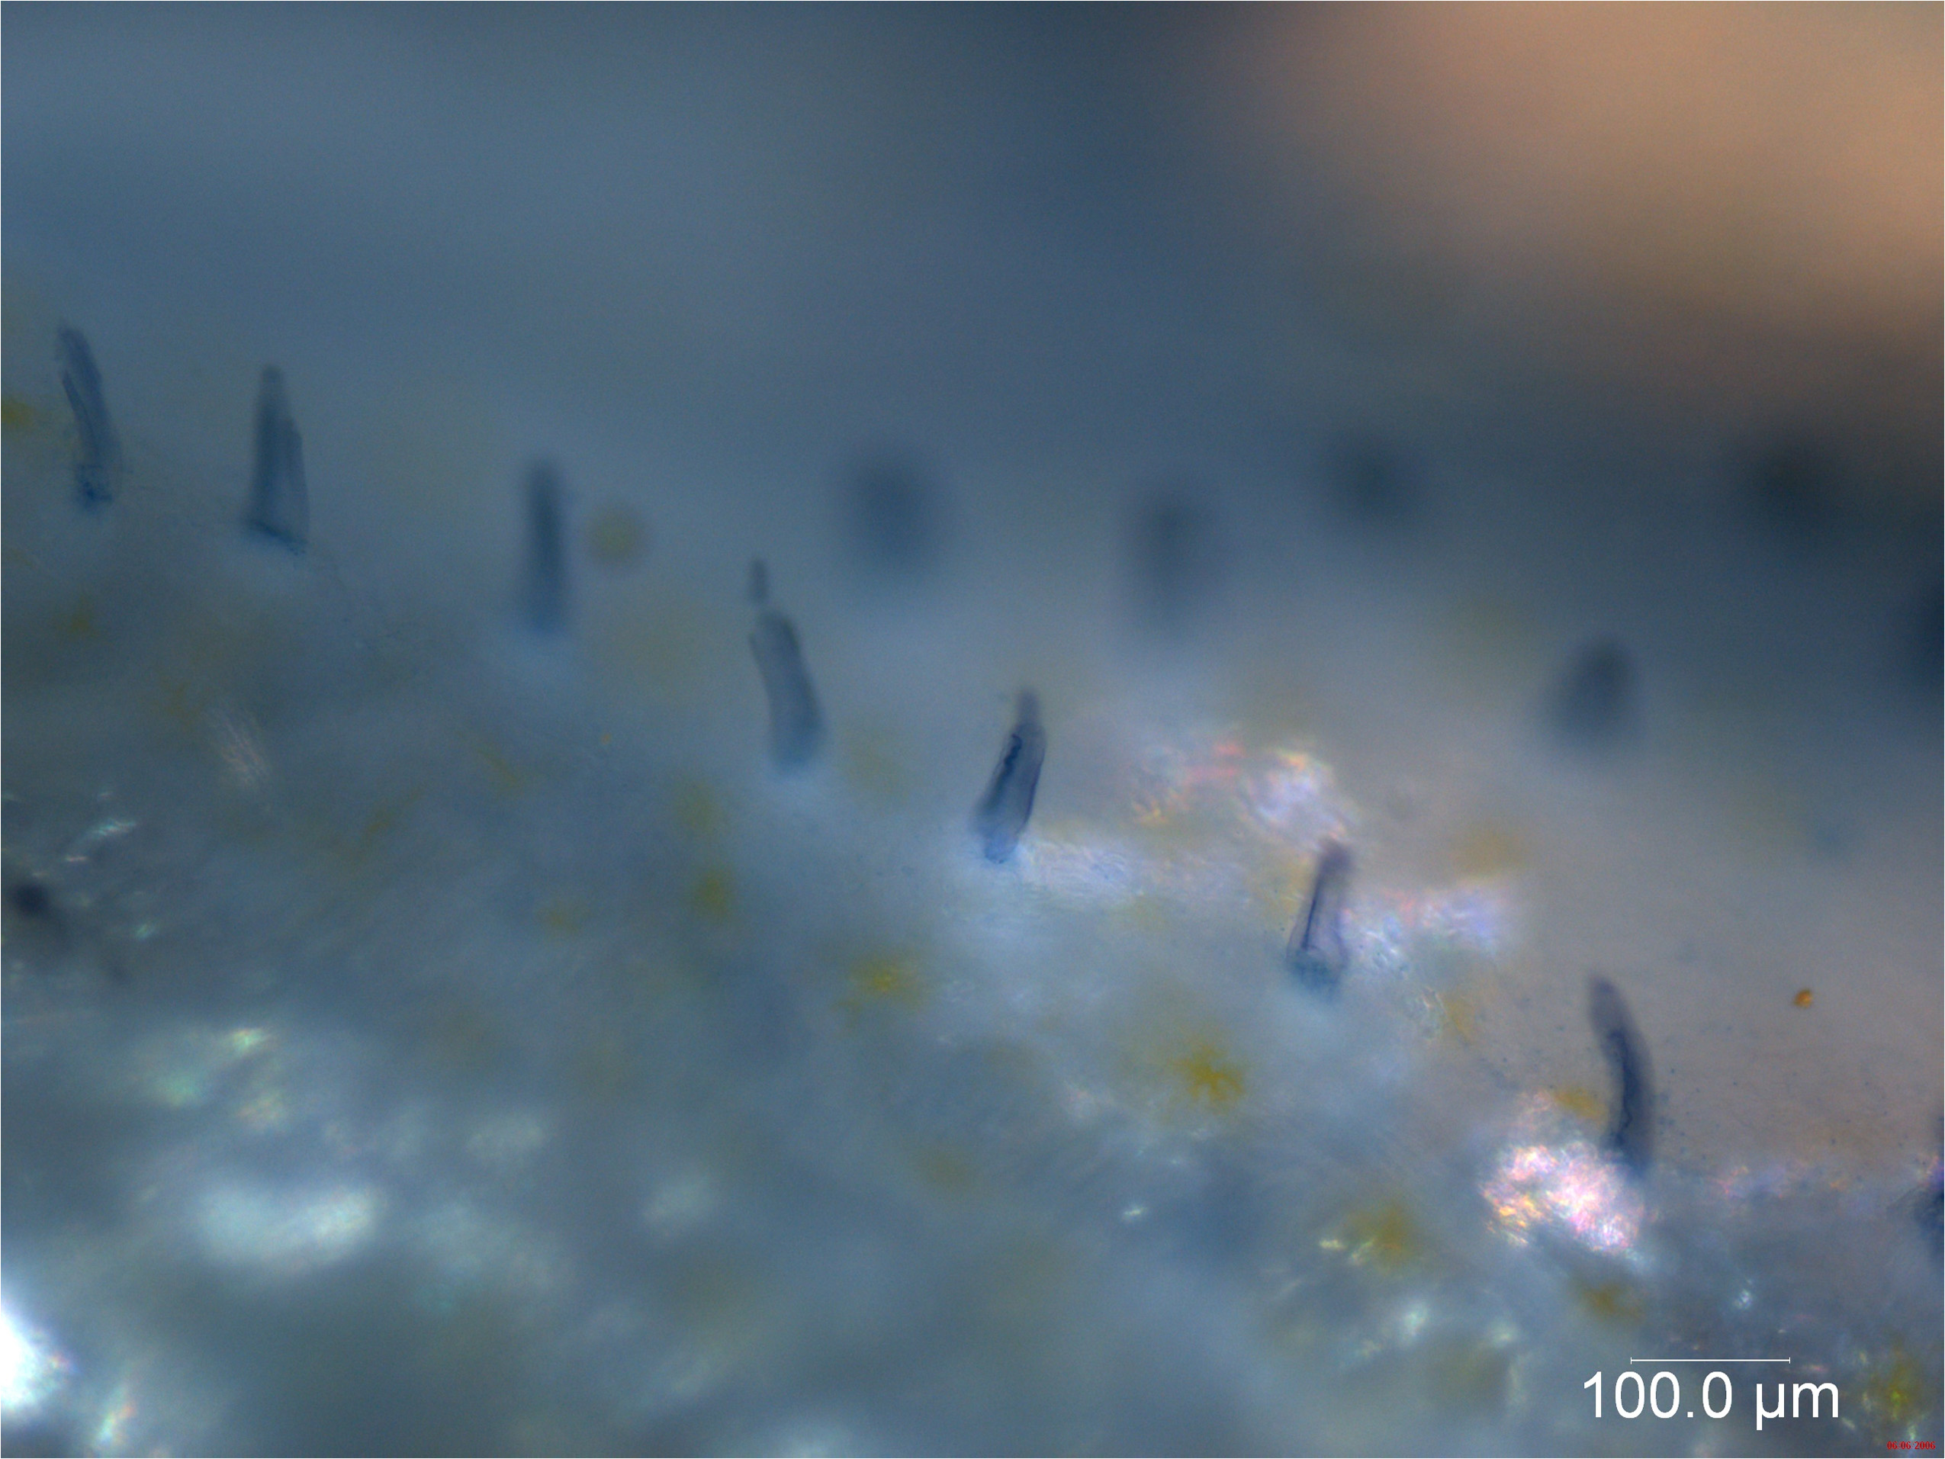
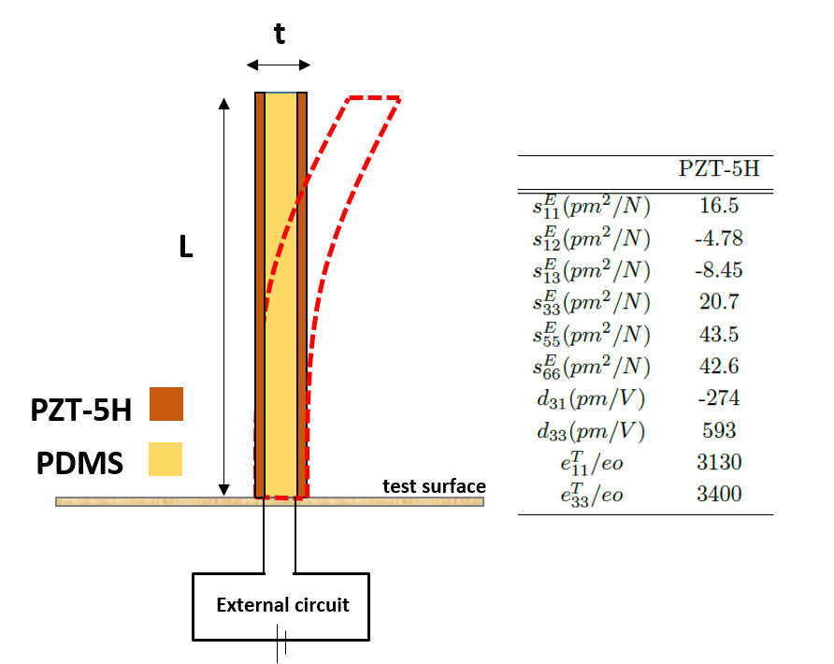
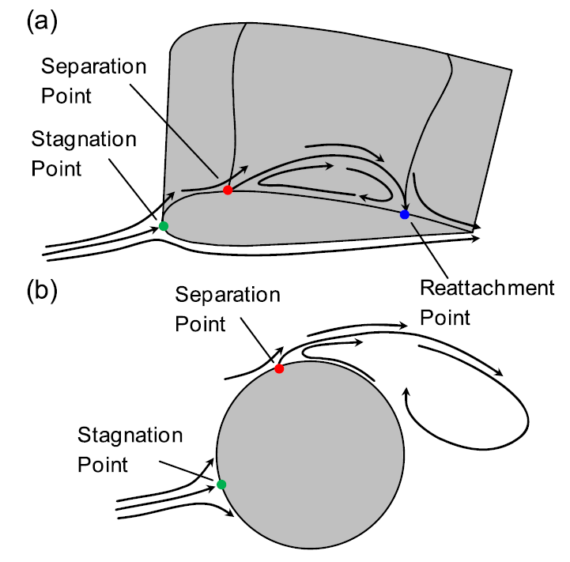
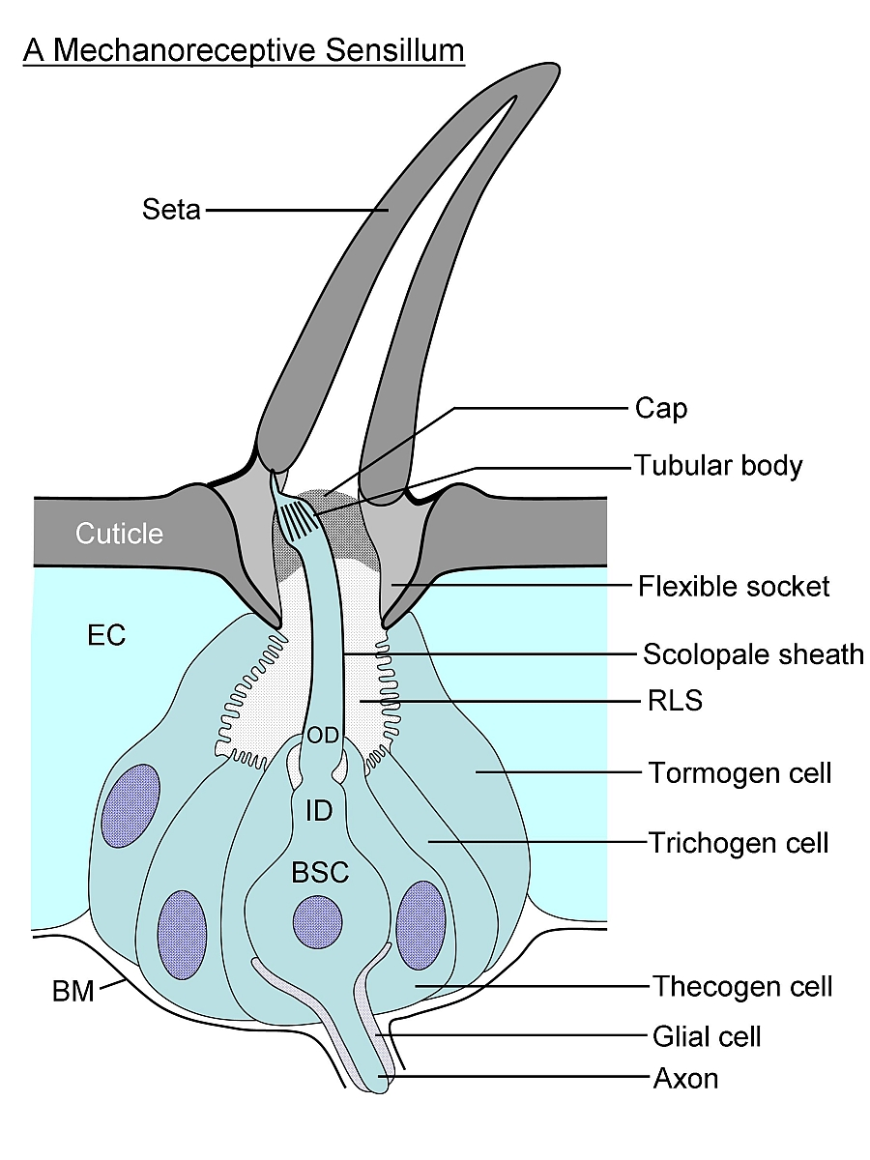
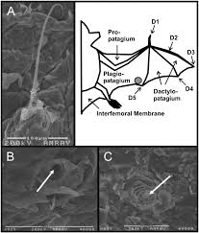
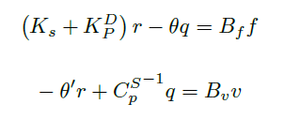
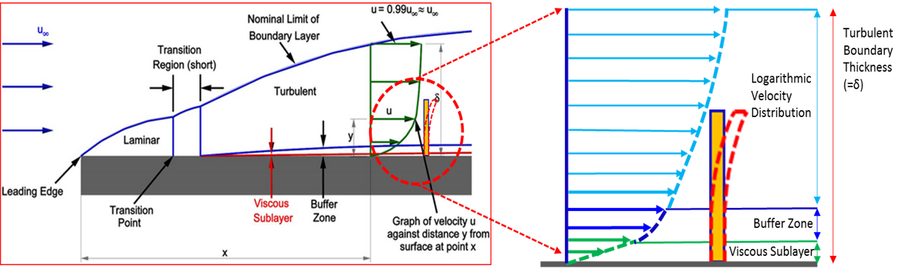
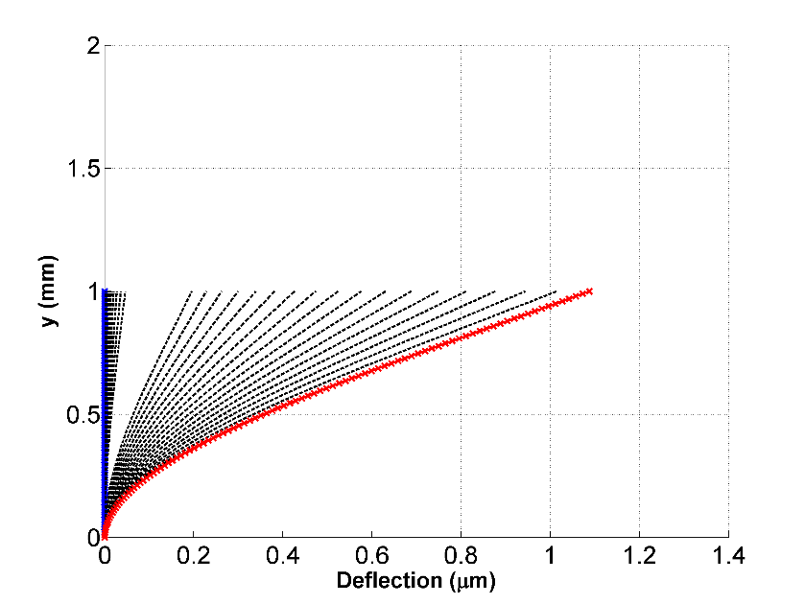
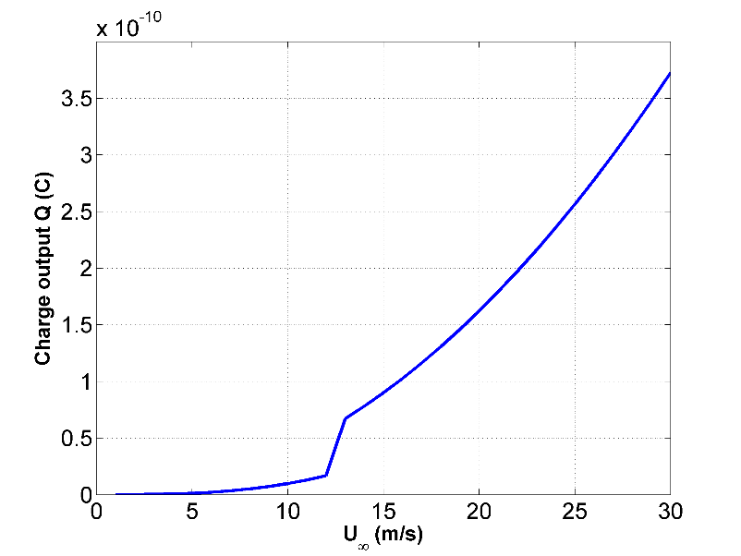
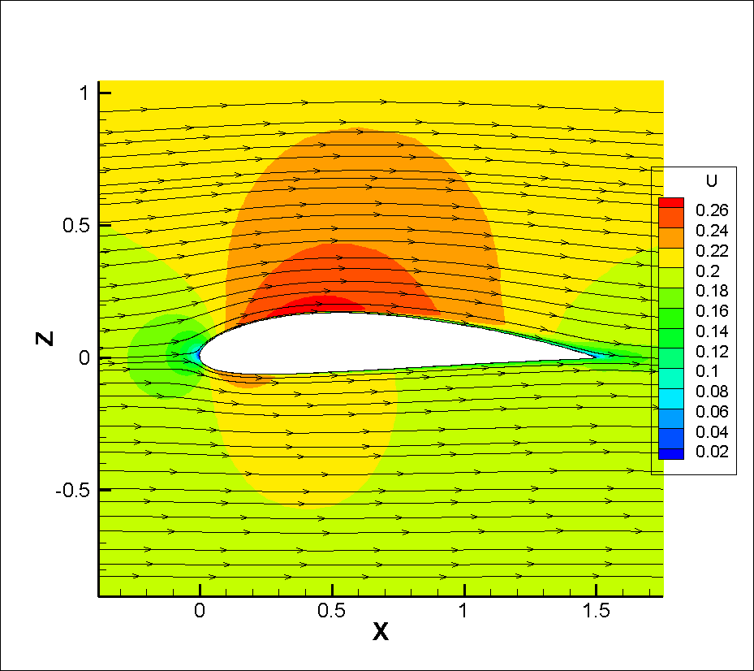
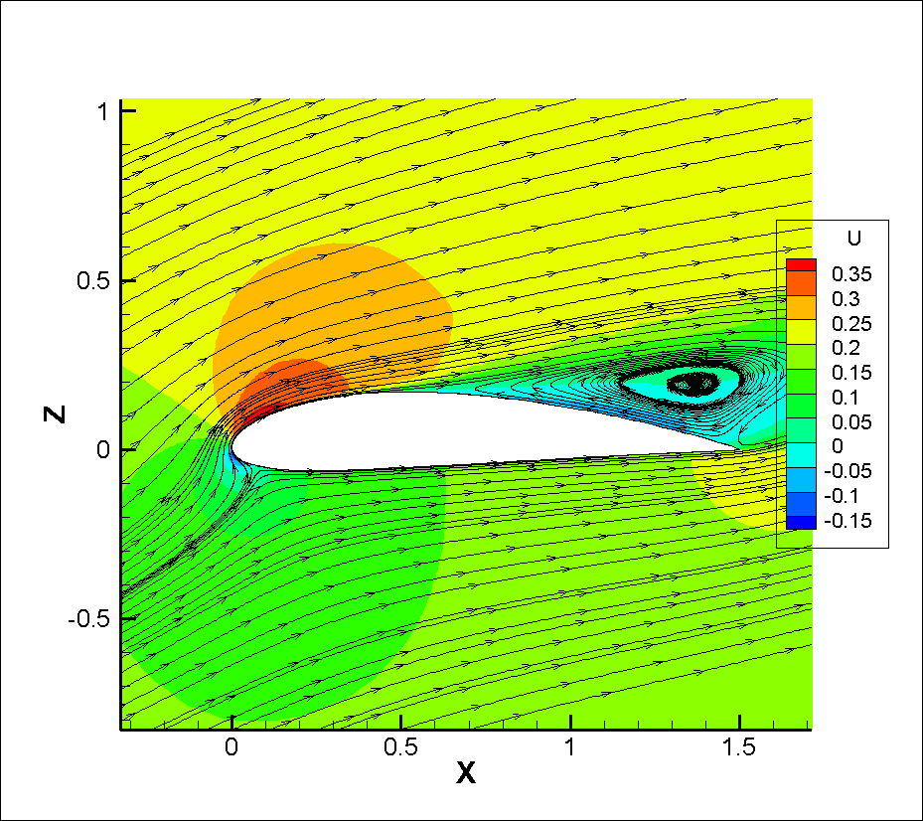
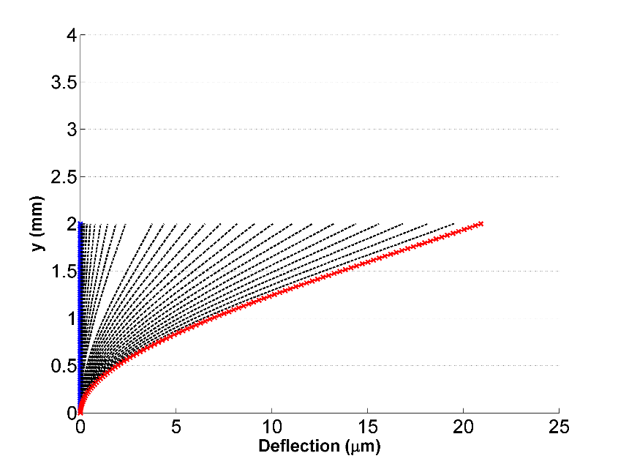
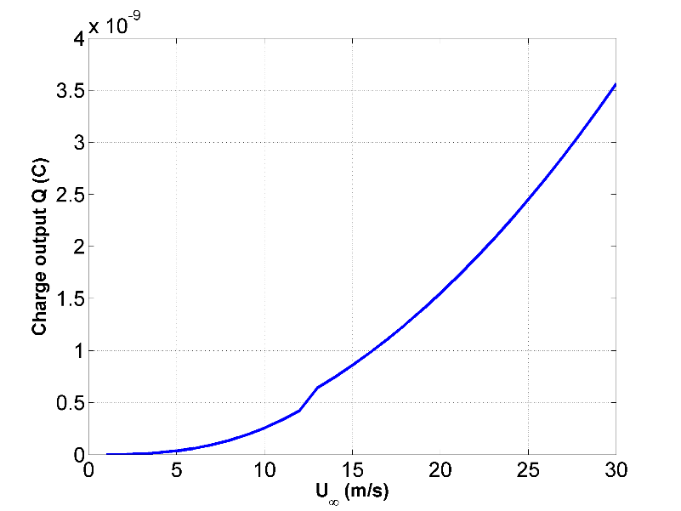
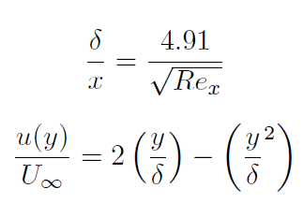
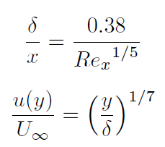
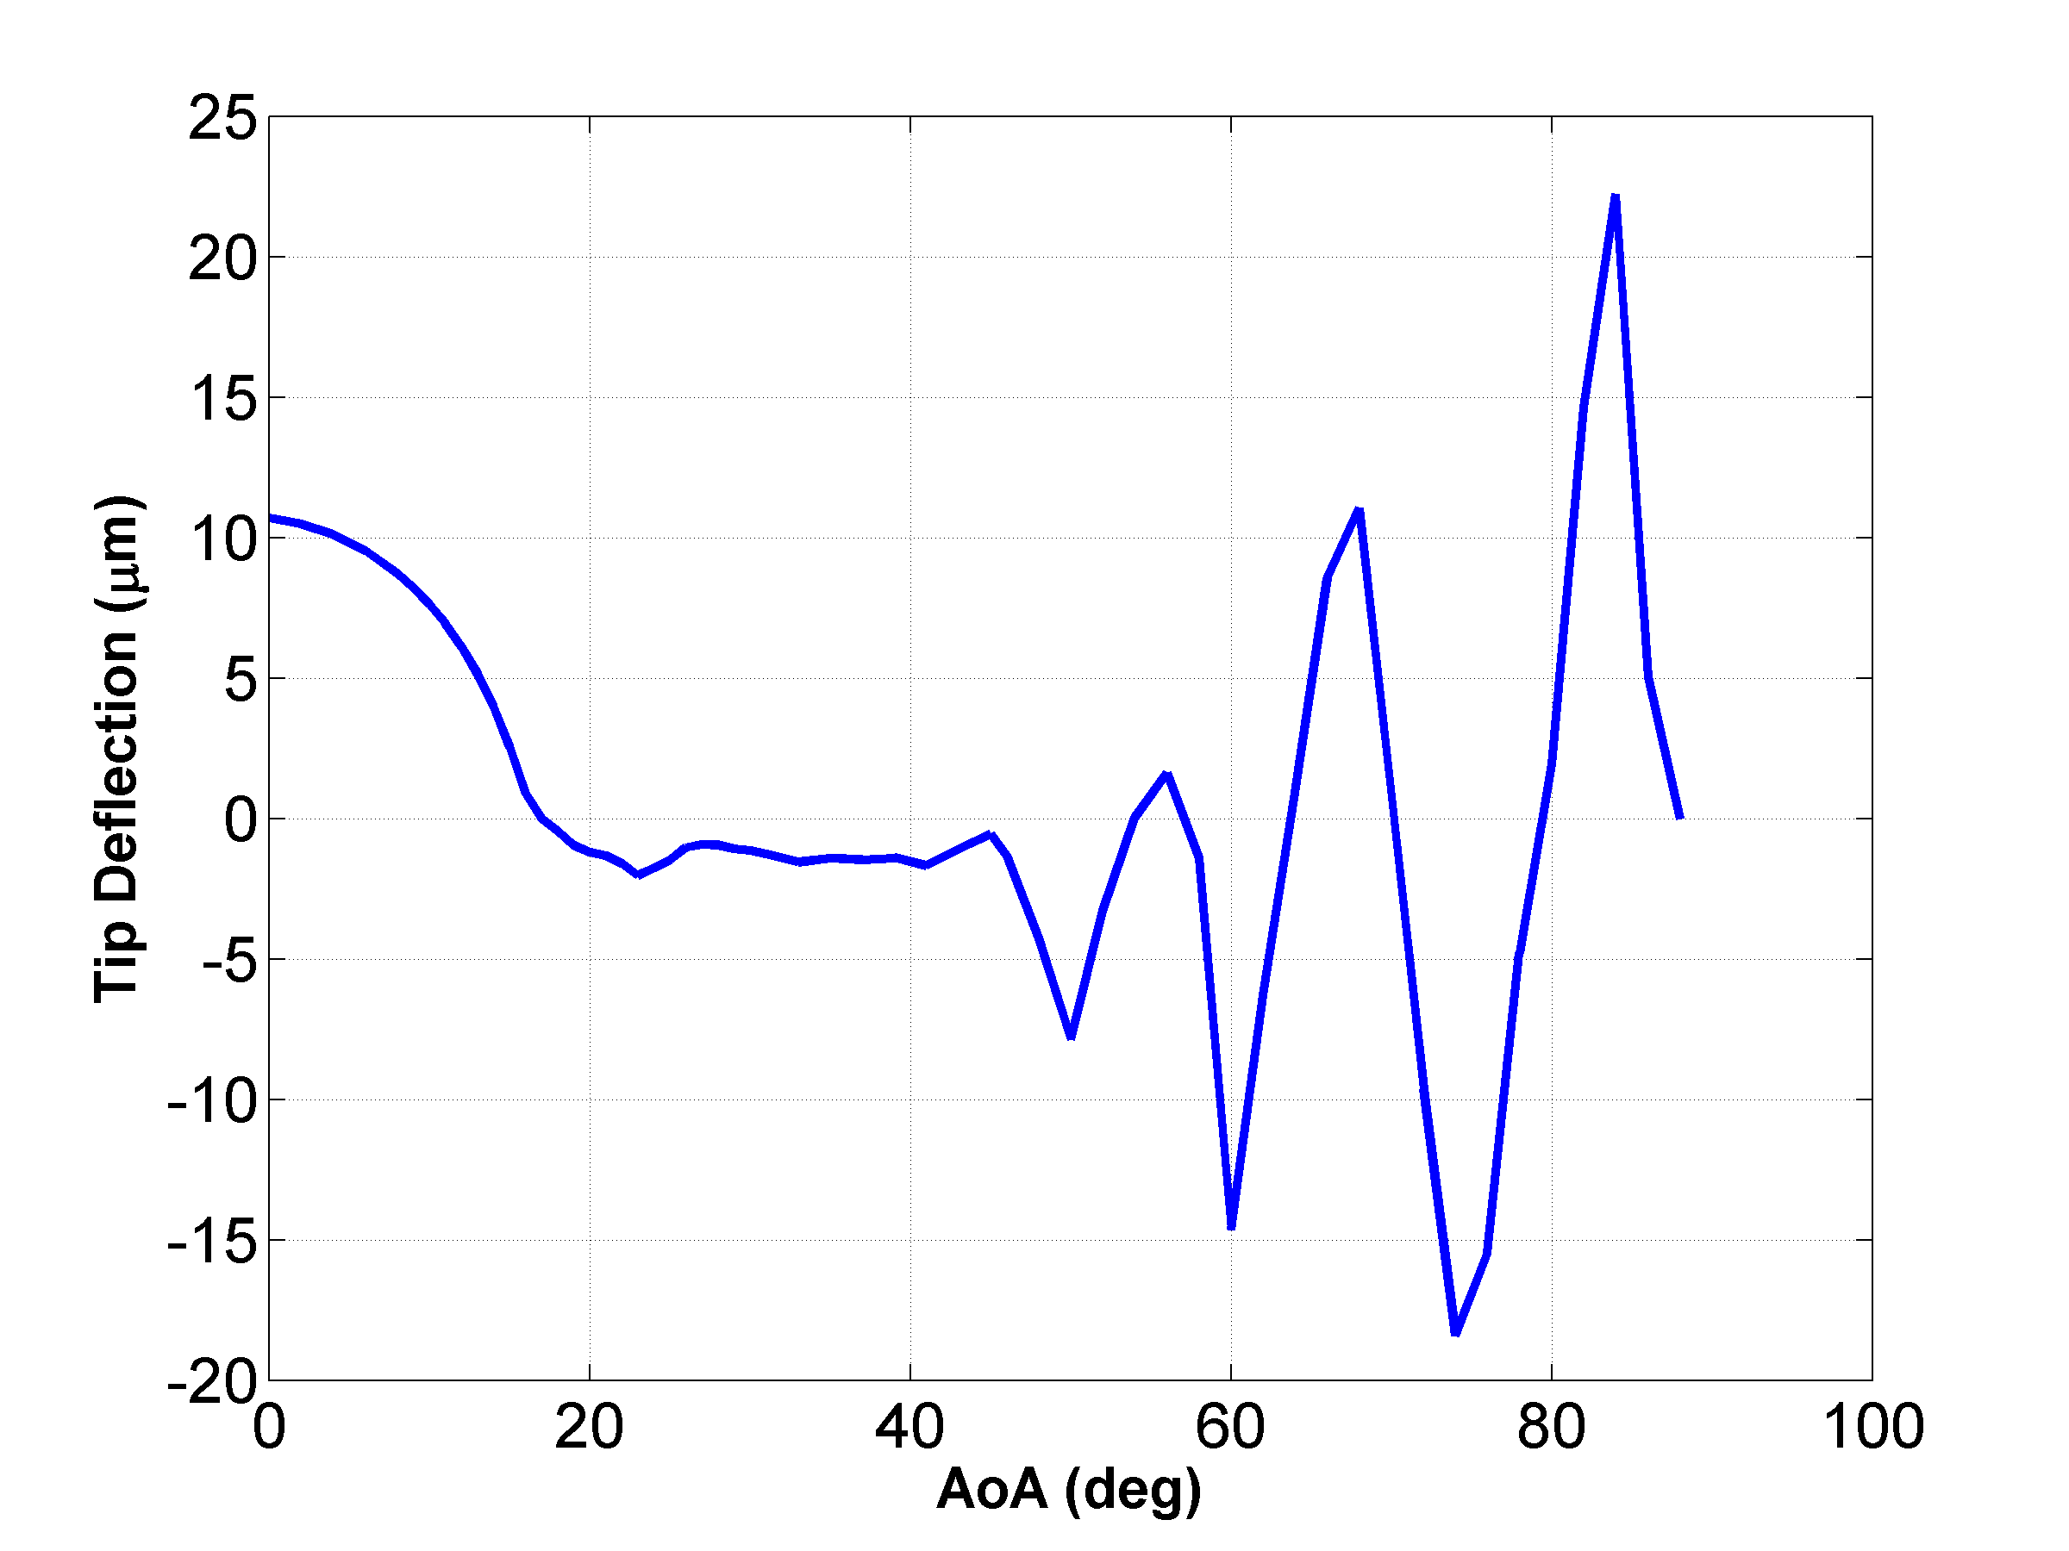
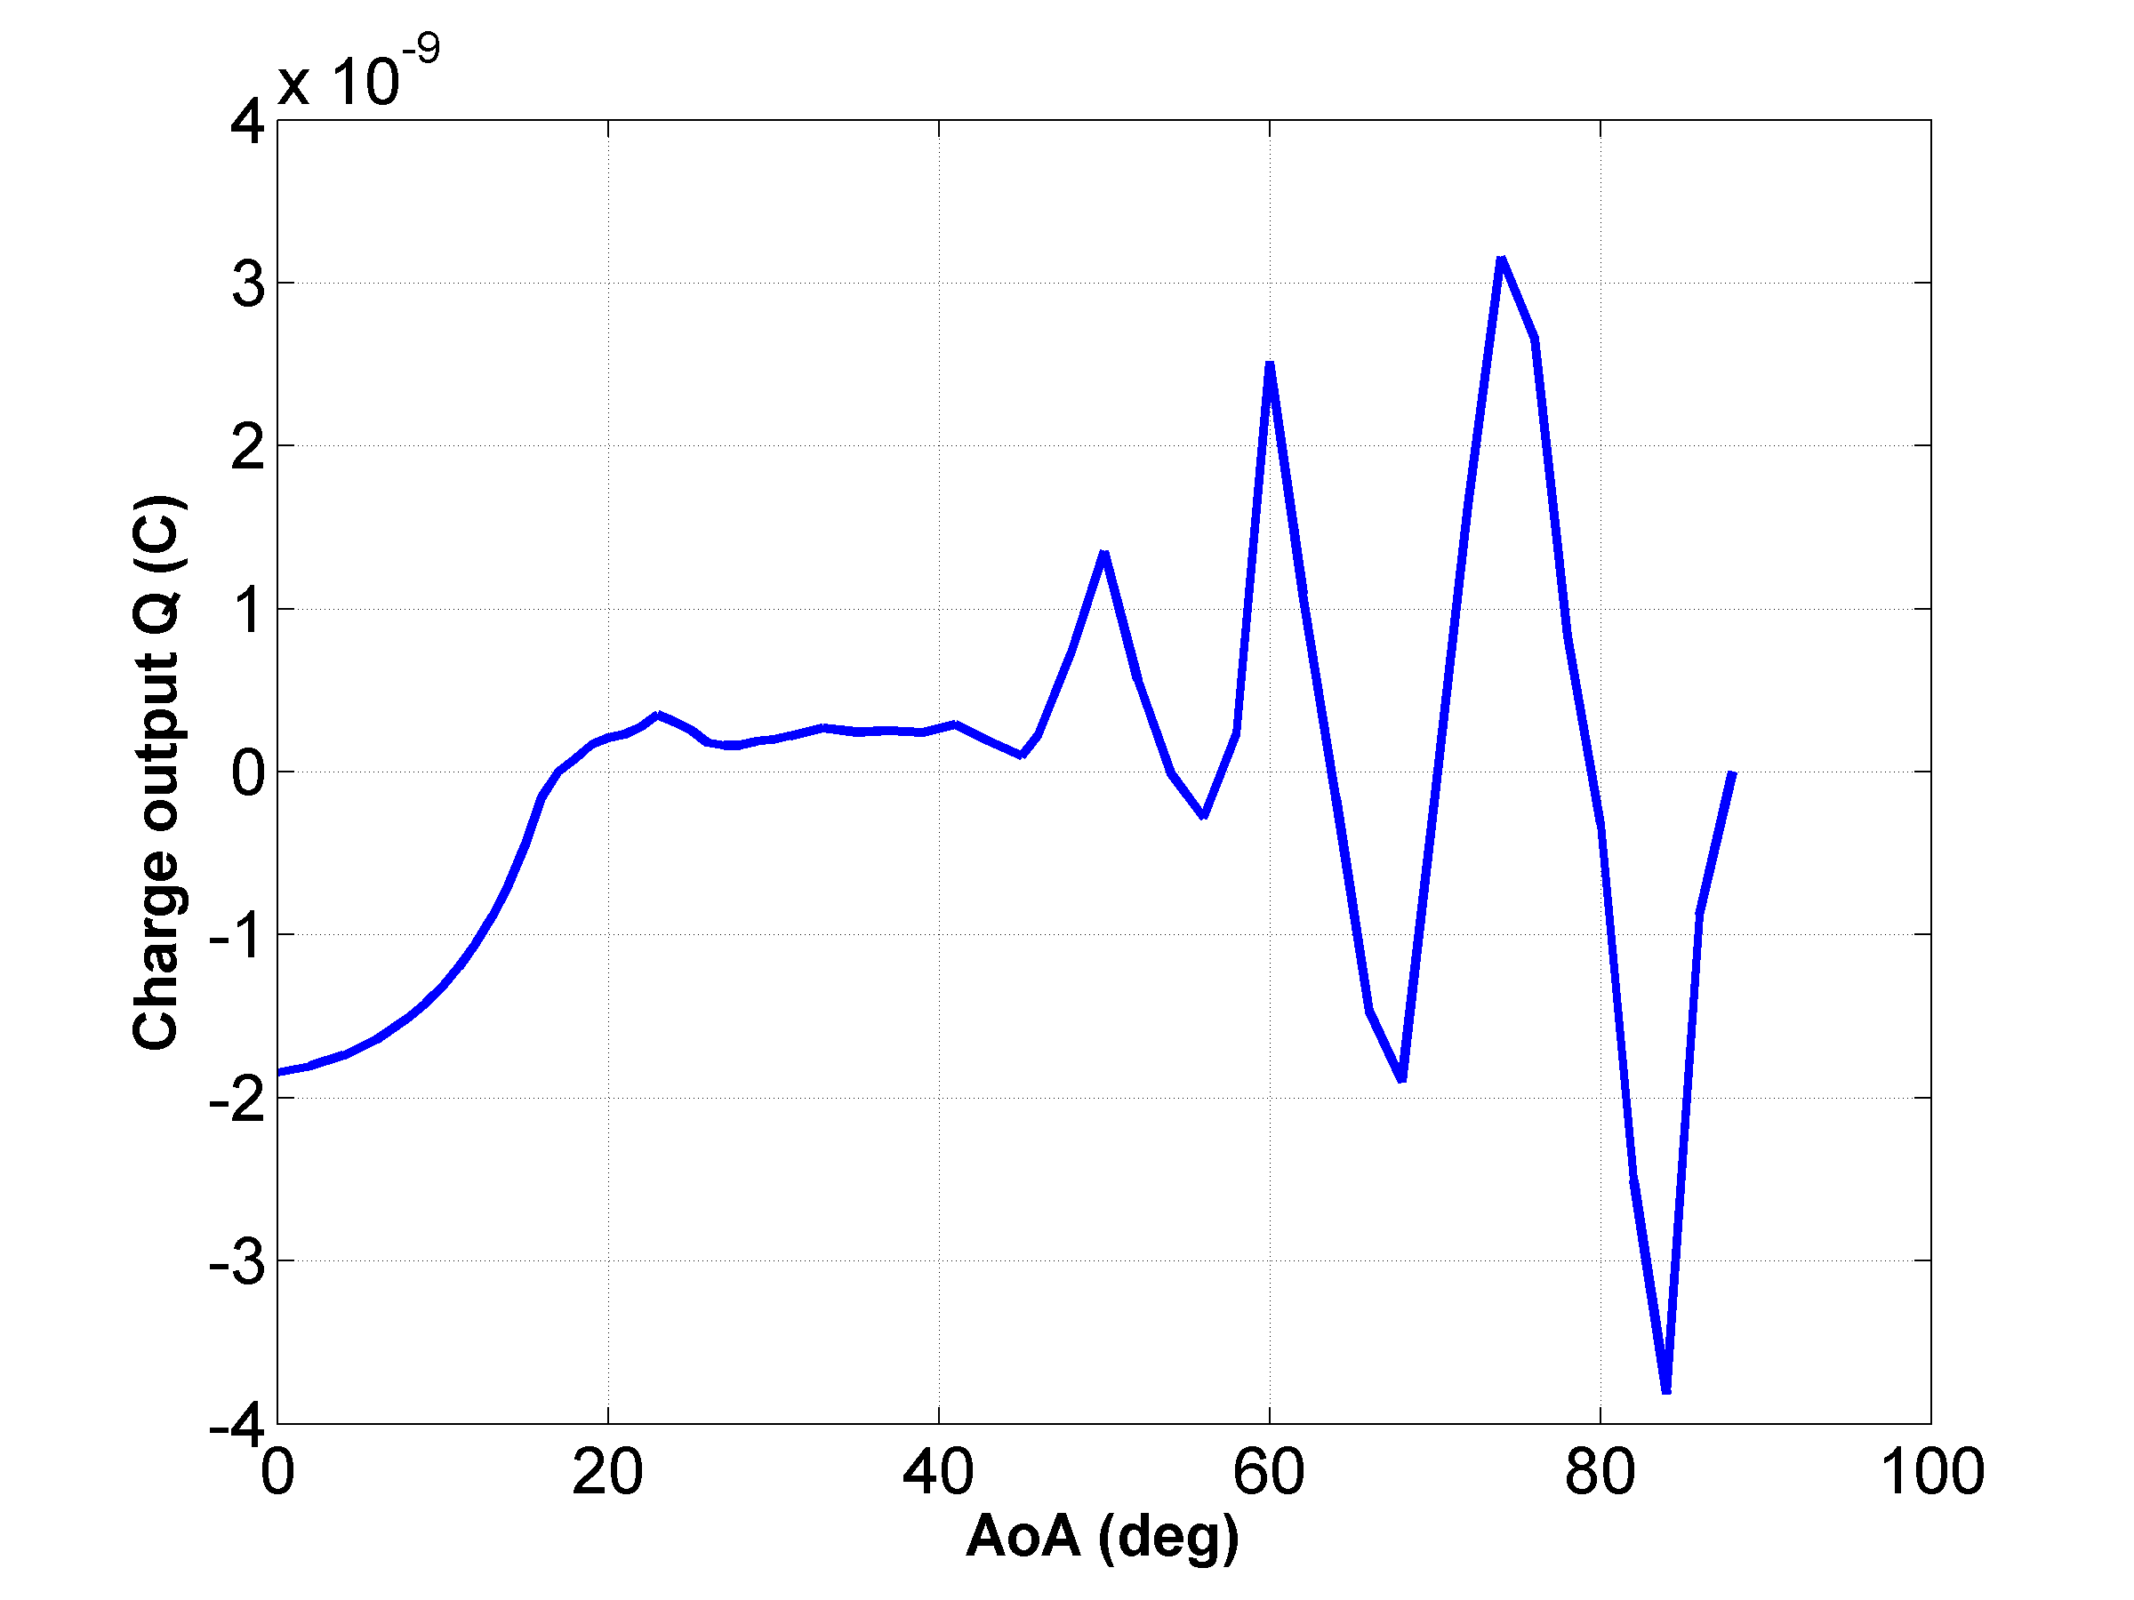
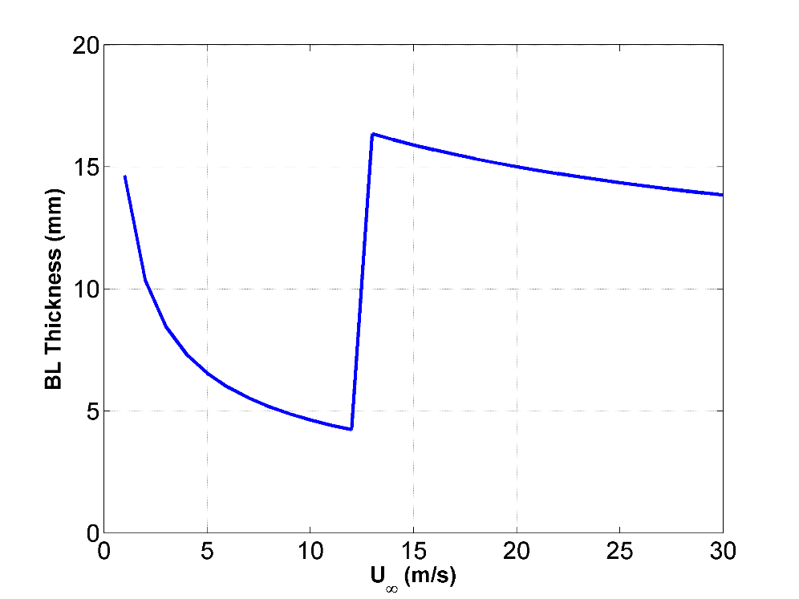
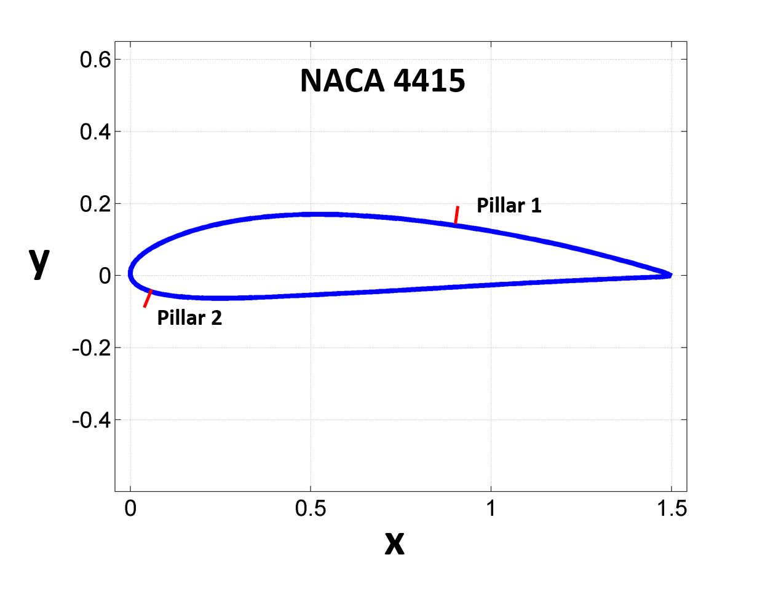
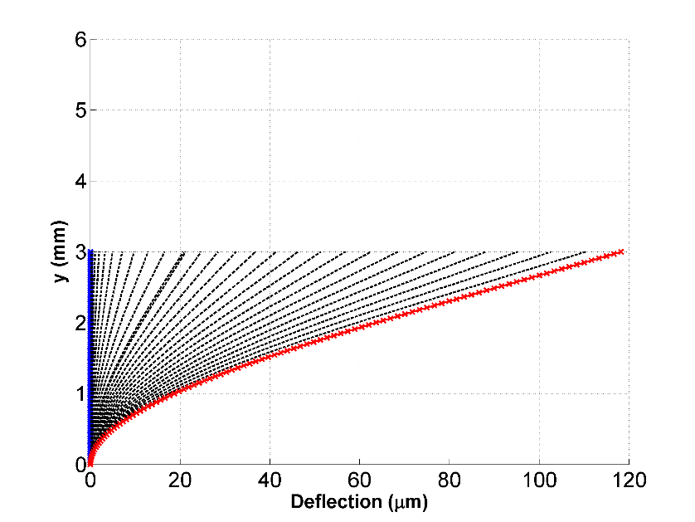
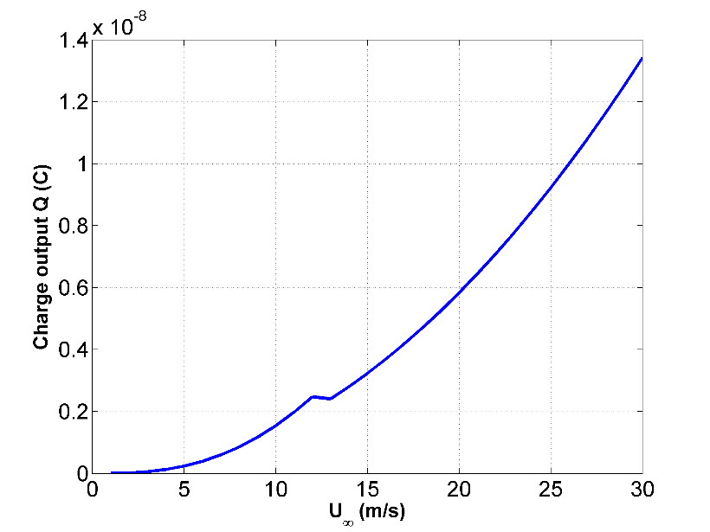
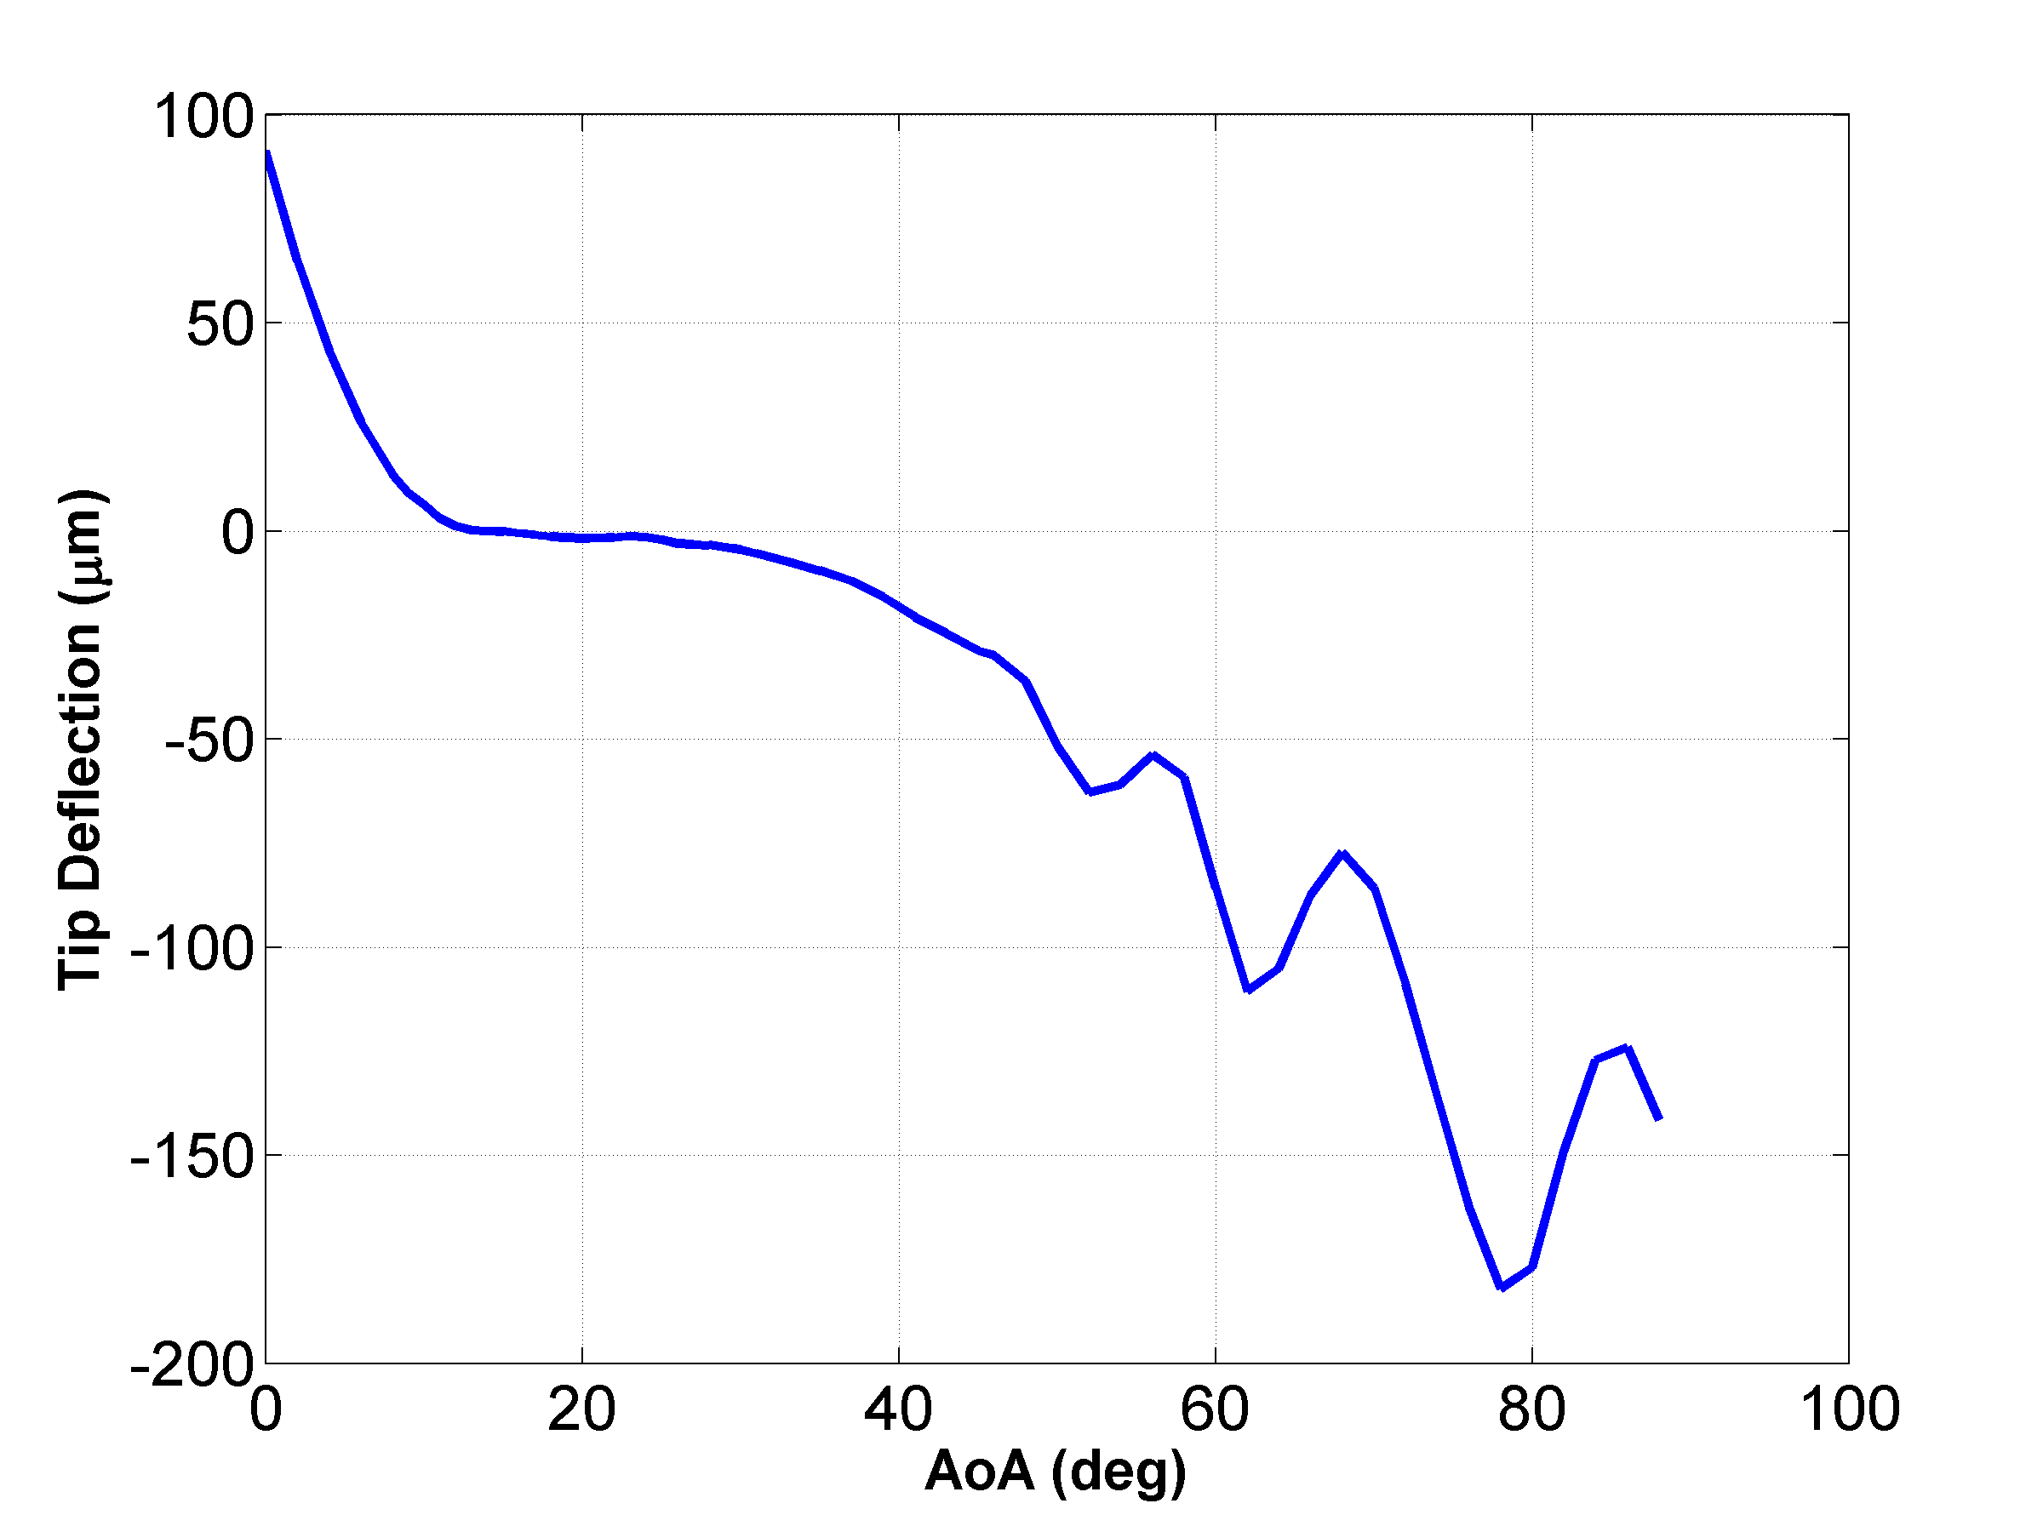
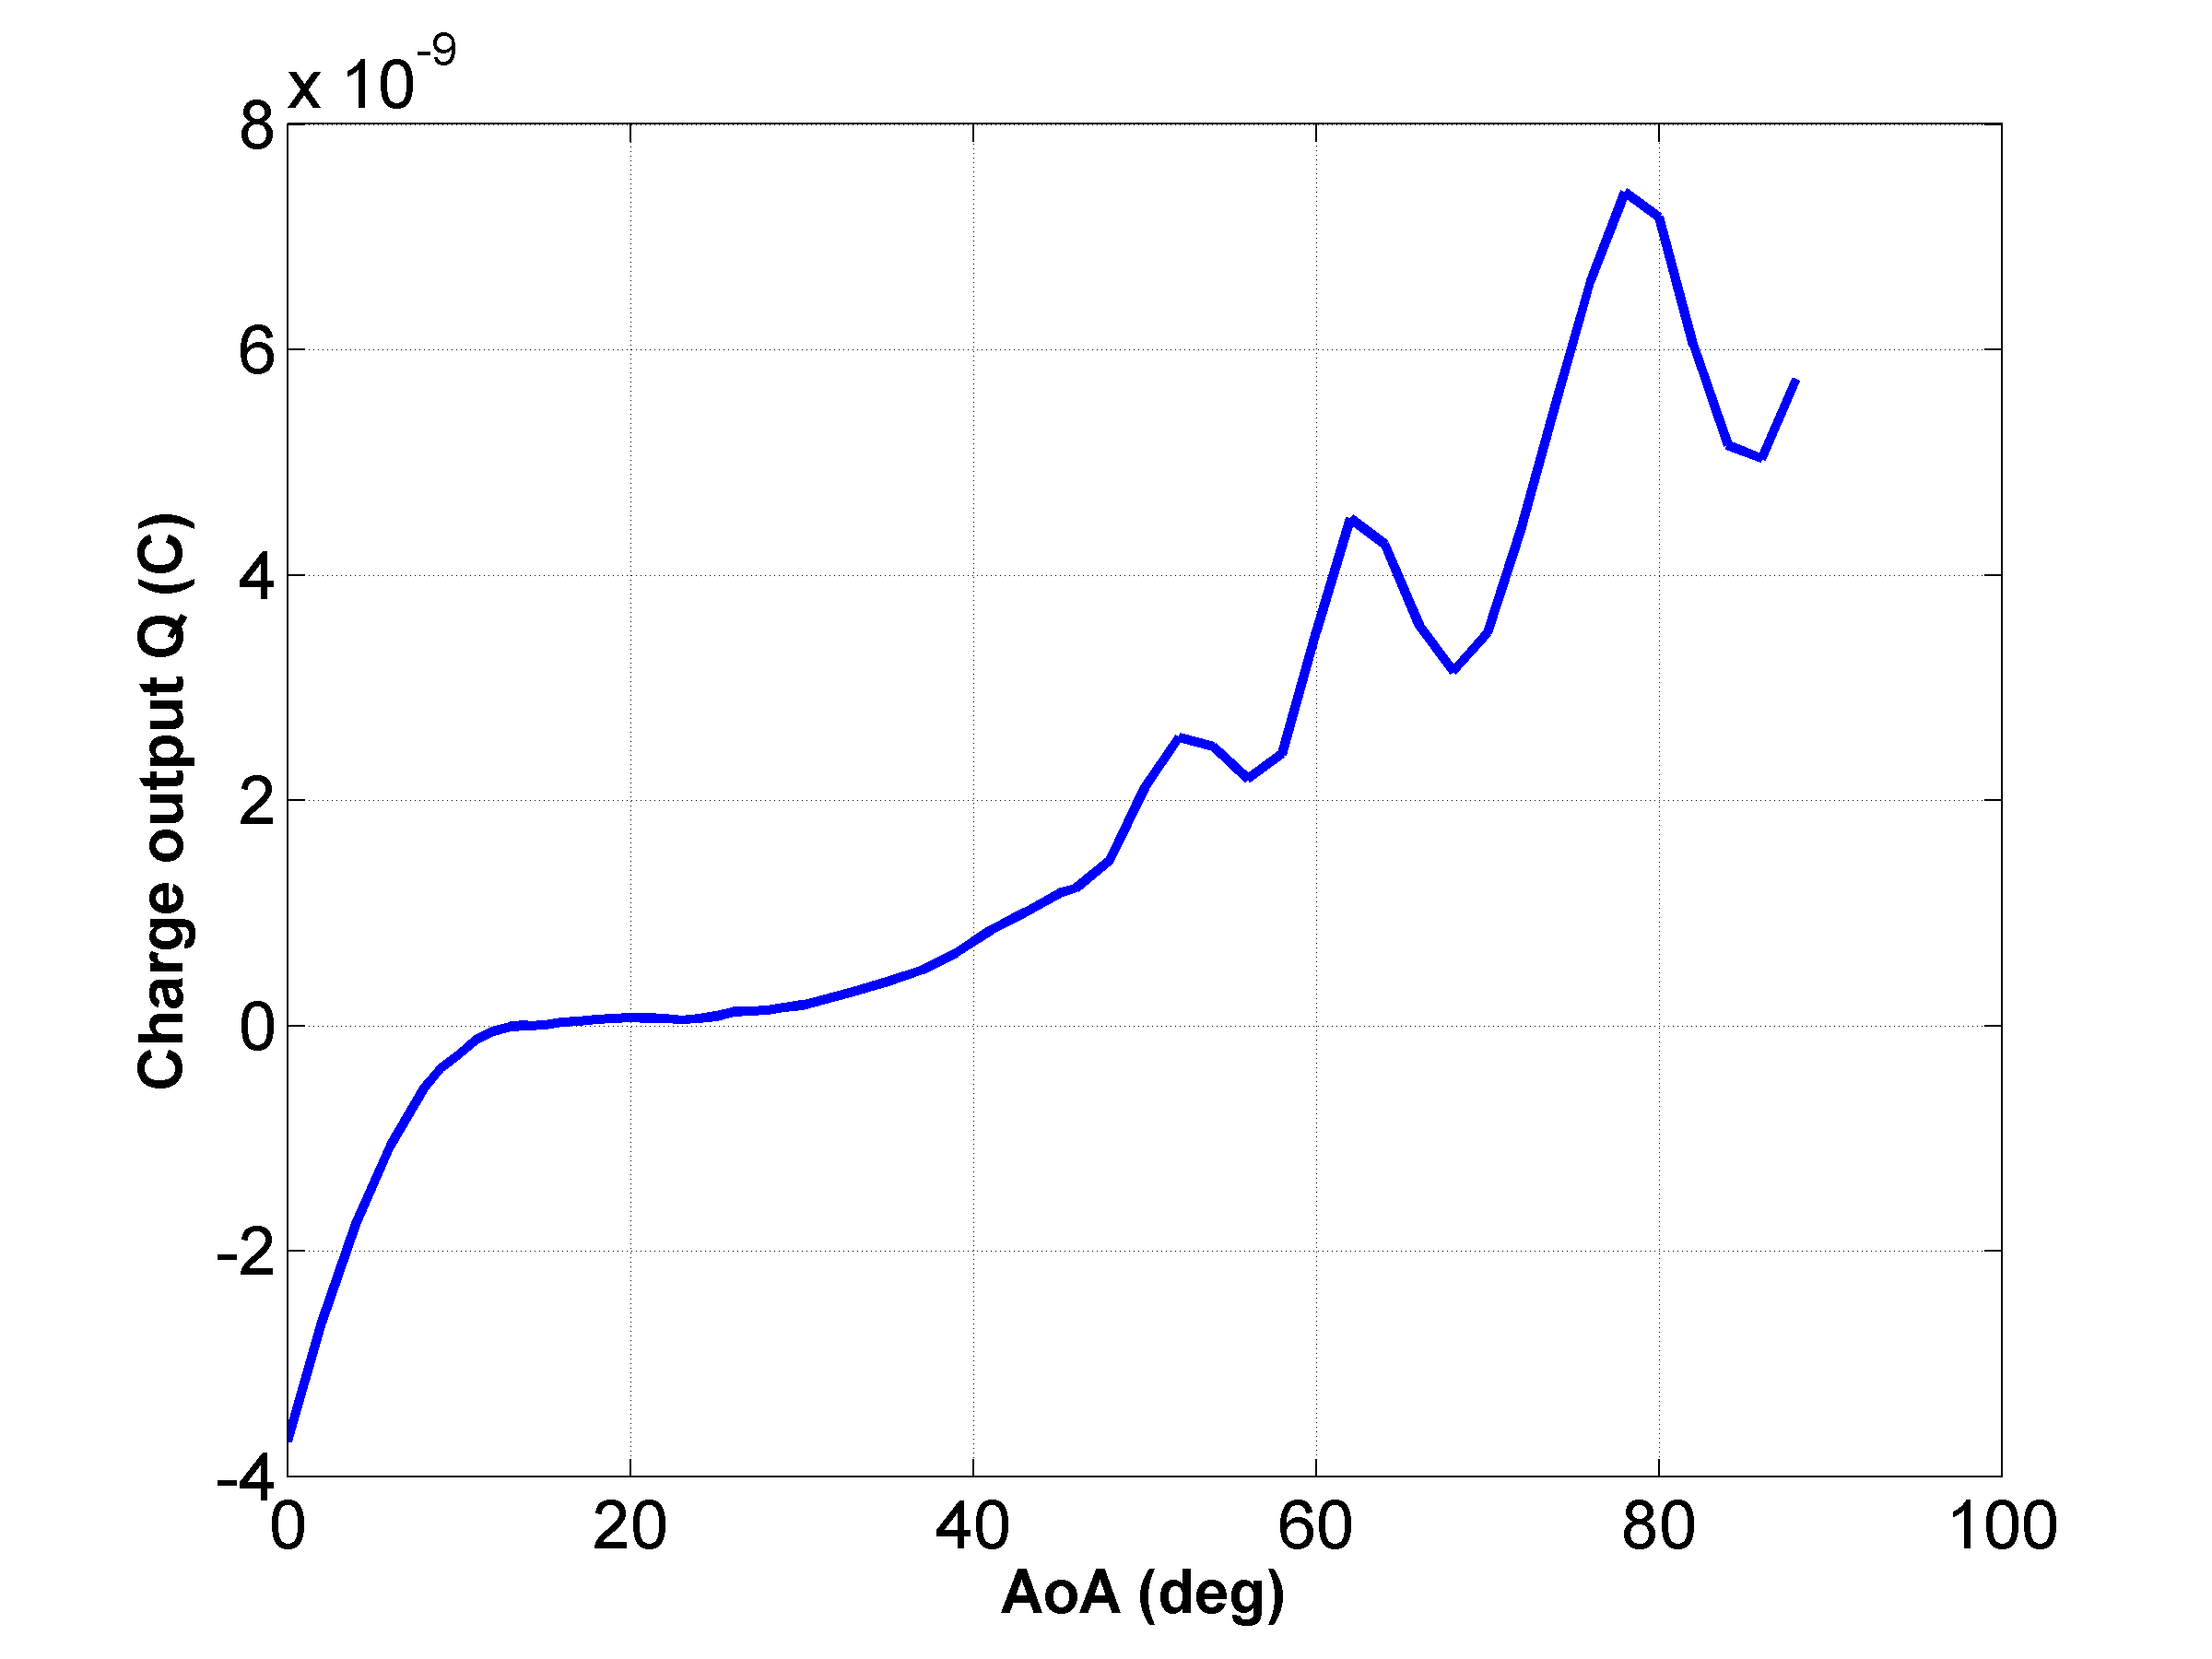
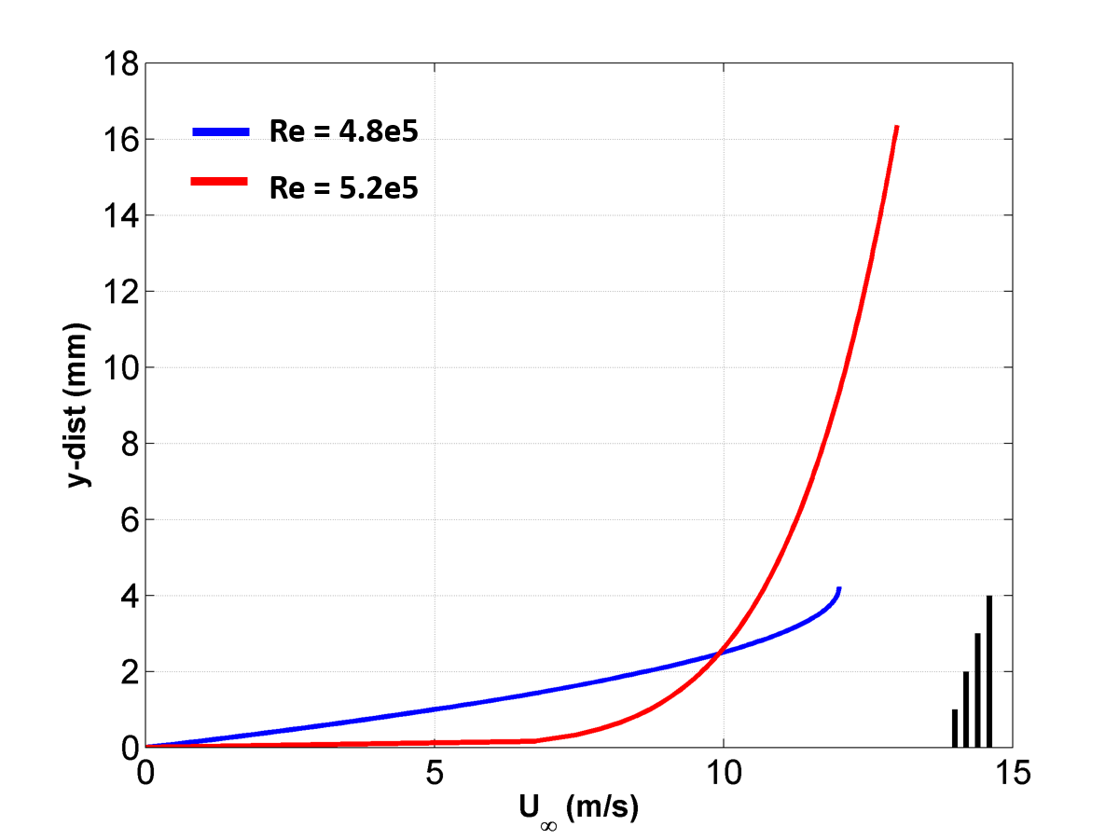
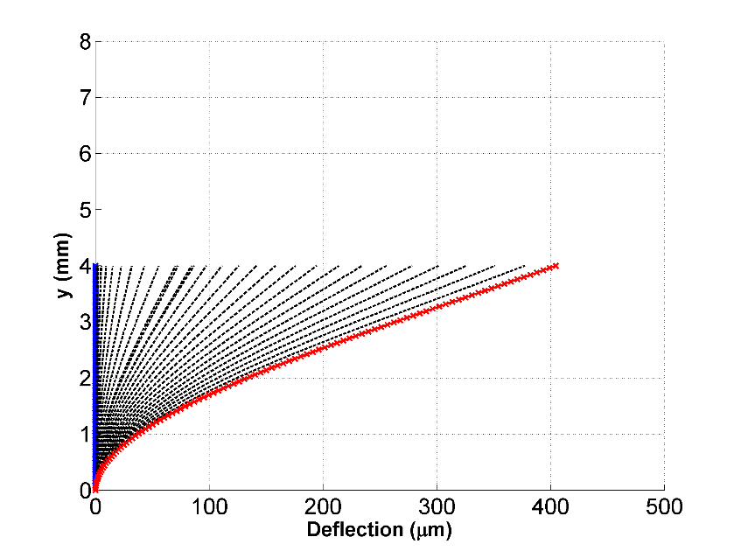
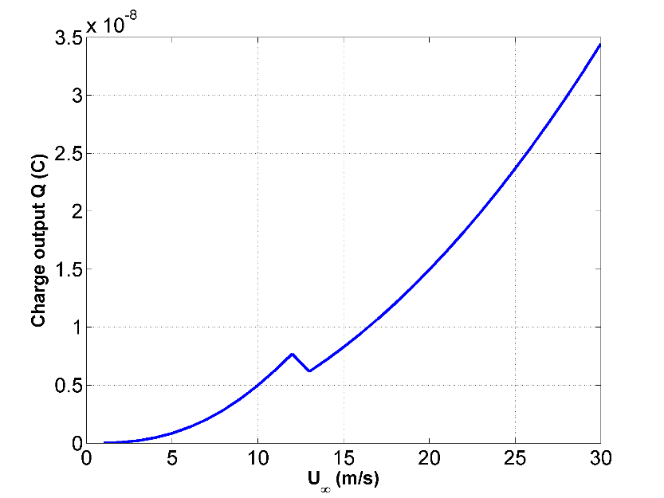
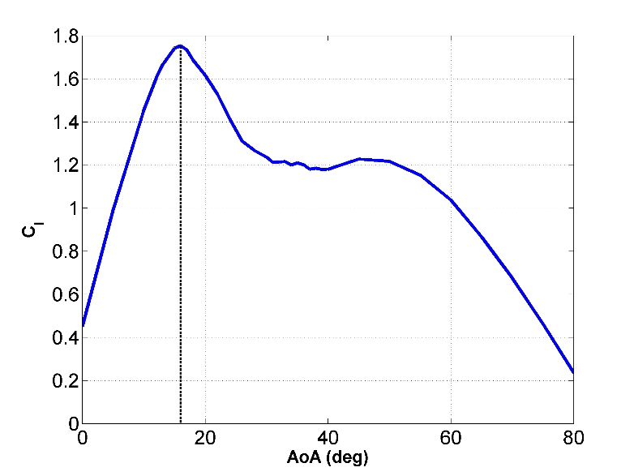
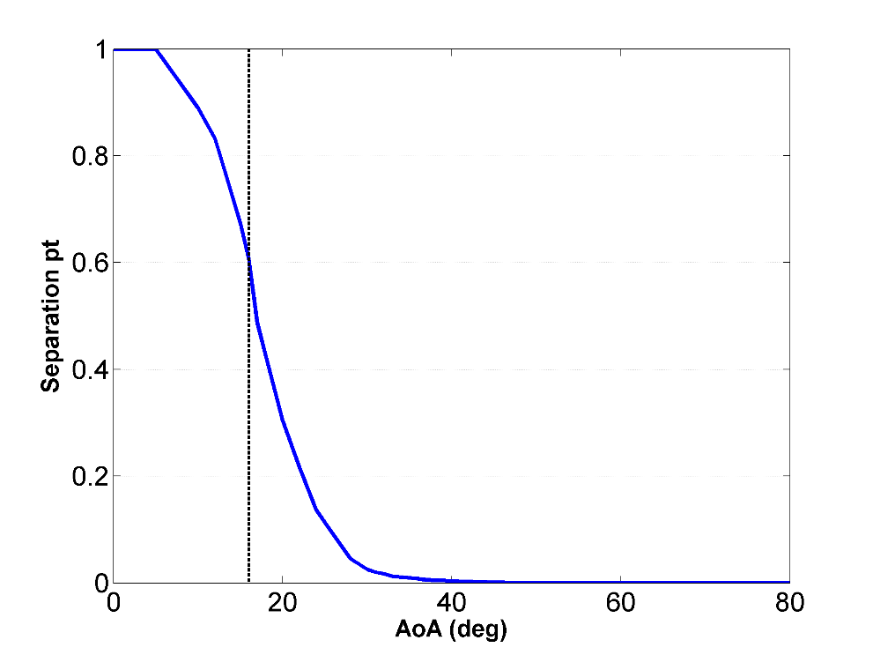
MAE 538 – Design of Smart Materials Systems
Artificial Hair Sensor For Aerodynamic Flow Sensing
Aditya Saini
Motivation and Overview
Formulation
Nature’s fliers and swimmers possess integrated sensory receptors that are adapted efficiently to detect any disturbing phenomenon during flight, as early as possible, and provide necessary feedback for control.
Birds and insects exploit such sensing in their wings to perform demanding flight maneuvers and maintain stability under wind gusts and flow disturbances.
Cantilever-type flow sensing hair receptors have inspired a new class of deflection-based wall shear stress sensors.
Artificial hair-like structures can be used for –
Assessment of flow rate
Measurement of shear stress
Identification of separation
and stagnation point locations
A cantilever bimorph design is considered for this flow sensing application .
The sensor consists of two piezoelectric layers bonded on the two side of a base elastic substrate.
The model for this piezo-system is developed using an energy formulation method.
Tsukruk et al., Georgia Tech
Real-time knowledge of the incoming aerodynamic flow can be crucial for stall sensing, enhanced flight performance, envelope protection and control.
Width = 400 µm
Thickness = 100 µm
“FLY- By- FEEL” Approach
Case - 1 : Flow over a Flat plate
Case - 2 : Flow over an Airfoil
Flow conditions
Results
Flow conditions
Results
The flow over a flat plate at zero angle of incidence (zero pressure gradient) is considered to characterize the response of the bimorph.
The charge output and the deflection profile of the pillar are able to identify the boundary layer velocity profile transition from laminar to turbulent.
CFD data was taken from previous research where Reynolds-Averaged Navier Stokes equations were solved for flow over wings and airfoils through post-stall angles of attack.
Data was taken for Re = 3 million for NACA 4415 wings and boundary layer velocity profiles were extracted at the mid-span section for the complete range of angles.
The charge output and pillar tip deflection were calculated for the pillars.
Pillar – 1 shows a change in deflection direction as the separation point reaches the sensor location at an angle of attack around 16 degrees.
While at very high angles of attack, the flow is completely separated and this can be seen in the sensor response.
This is also reflected in the charge output of this piezoelectric bimorph system.
Pillar – 2 is also able to register a change in deflection direction as the stagnation point crosses this micropillar location near the leading edge of the airfoil.
Illustration of boundary layer velocity profiles
Lp = 1 mm
AoA : 0 deg
AoA : 20 deg
The flat plate was 1 m long and the micropillar was place at 0.6 m from the leading edge. The flow velocity was varied from
1 m/s to 30 m/s.
Lp = 2 mm
Blasius solution was used to simulate the boundary layer velocity profiles in the laminar and turbulent region.
As the free-stream velocity is increased, flow transition is considered as the local Reynolds number at the sensor location reaches 500,000.
The height of the micropillar was also varied from 1 mm to 4 mm.
The boundary layer thickness decreases with increasing velocity and the objective here was to study the effect of the pillar height on its ability to detect boundary layer transition.
Laminar BL
Turbulent BL
Two micropillars were considered in this case at two different locations on the airfoil.
Pillar 1 : At 60% chord to detect the onset of flow separation.
Pillar 2 : At 3.5 % chord on the lower surface to track the stagnation point.
Pillar - 1
Pillar - 1
Lp = 3 mm
Lift coefficient vs. AoA
Separation pt. vs. AoA
Pillar - 2
Lp = 4 mm
asaini2@ncsu.edu

